Slide 1
FINAL ASSESSMENT

Slide 2

QUESTION-1
=DAYS(end_date,start_date)
The time difference between request date and work date is found using the DAYS function in excel above.
Using that we can find the avg of time between req and work date in pivot table.
The avg lead time is 323 days approximately. The negative symbol symbolises some works are completed after work date and some before the work date.

Slide 3
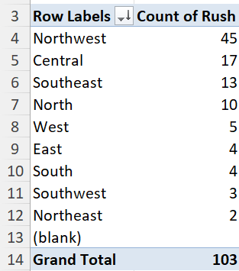

QUESTION-2
The no of rush jobs for each district is found using the pivot table where the row value comprises of each district names and the values column comprises rush count.
It is clear from the table that the Northwest district has highest no of rush jobs with 45 to its name. It can be highlighted using the label Top10 filter present in the pivot table.

Slide 4
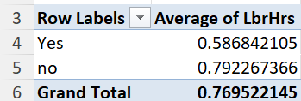
QUESTION-3
The avg labour hours for rush jobs and non rush jobs can be found using pivot table where the “Yes” column in the above image comprises the avg of labour hours for rush jobs and the “no” column, the vice versa.
It can be clearly inferred that the average labour hours for rush jobs are less than non rush jobs since it is obvious that rush jobs must be completed within short period of time.
The labour cost and labour fee are further reflected with both being higher for non rush jobs.

Slide 5
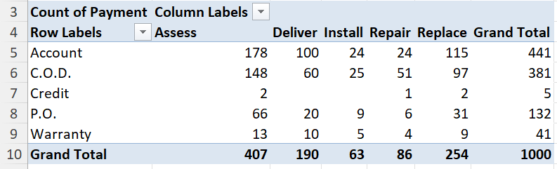
QUESTION-4
The distribution of payment types across different services is shown in the above image.
It is clear that the distribution of all the payment types for assess service is higher compared to all other services like deliver,install,etc.
It is also pretty clear that assess services has more work orders compared to other 4.

Slide 6
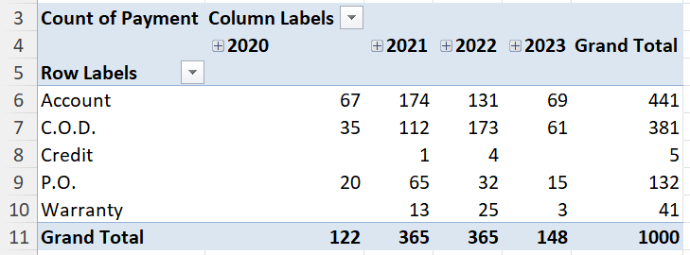
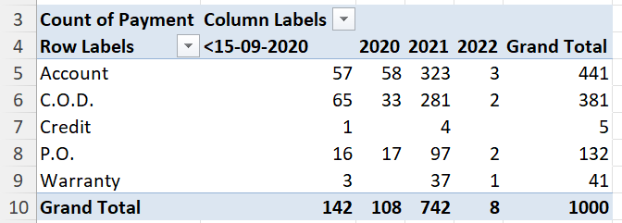
QUESTION-5
The distribution in payment systems over the years for request date is fluctuating as such.
The distribution in payment systems for workdate increases over the years that is clear from the second table.

Slide 7
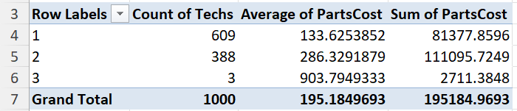
QUESTION-6
The parts cost for each no of techs can be clearly observed from the above table.
The total parts cost for each no of techs is higher when a work requires 2 techs.
But when we calculate the avg of parts cost, the work that needs 3 techs requires more cost than for works that needed either 1 or 2 techs.

Slide 8
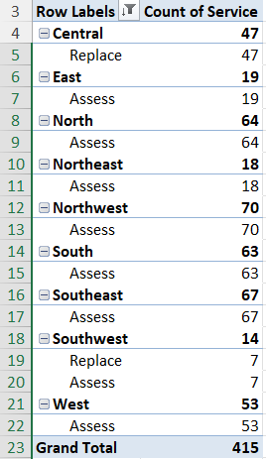
QUESTION-7
For finding the most common service in each district we need to find the top services in each district using top10 label filter in pivot table.
Using that the count of services that is most common in each district is found.
Assess service is the most common service requested in each district with 7 districts followed by replace service in two of the districts(Central and Southwest).

Slide 9
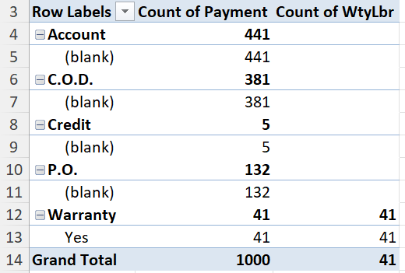
QUESTION-8
The work orders with warranty labour are found only for the warranty payment type as shown in the table.
There are totally 41 warranty work orders that are totally allocated only to warranty payment.
The other column shows the total count of payment without warranty labour.

Slide 10
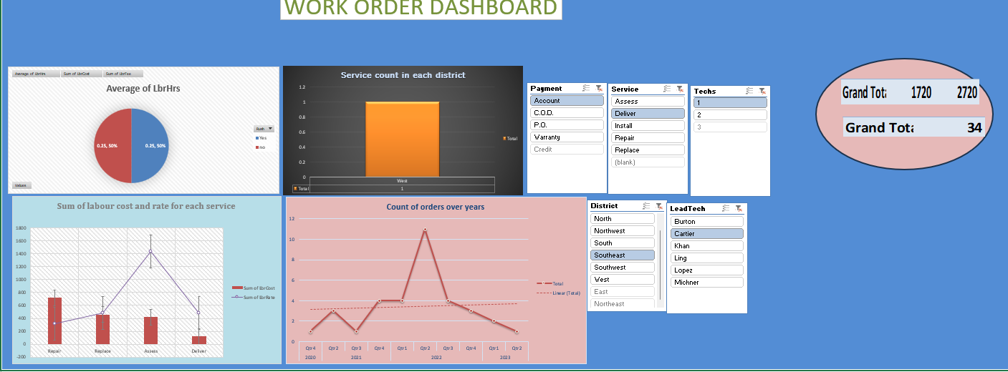
DASHBOARD

